Slide 1
Subconscious Reprogramming

Slide 2
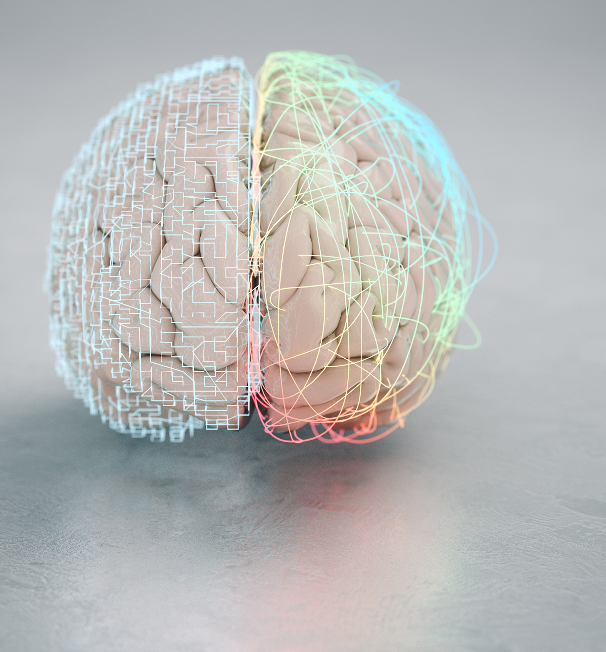
Introduction
The subconscious mind is the part of our consciousness that stores memories, habits, and beliefs outside of our conscious awareness.
It is responsible for 95-97% of our thoughts, beliefs, and emotions.
It forms the lens through which we see and interact with the world.

Slide 3
What is the Subconscious Mind?
The subconscious is the storehouse of automatic behaviors and deeply ingrained patterns.
It plays a role in shaping our beliefs, values, and self-image.
It stores memories and experiences, often influencing current behavior without conscious awareness.

Slide 4
The Impact of the Subconscious Mind
Habits and Conditioning: How habits are formed and how they can be reshaped.
Emotional Responses: The subconscious influences emotional reactions, sometimes based on past experiences.
Limitations and Beliefs: Many limiting beliefs (Ex: I’m not enough) are deeply ingrained in the subconscious.
Decision Making: Most of the decisions are made subconsciously, affecting both personal and professional lives.

Slide 5
Why Reprogram the Subconscious Mind?
Achieve Goals
Overcome Limiting Beliefs
Improve Mental, Emotional & Spiritual Health
Increased Confidence & Self-Esteem

Slide 6
Methods of Subconscious Reprogramming
Affirmations
Positive statements to combat negative beliefs…helps shift thought patterns over time.
Visualization
Creating vivid mental images of your desired outcome to help subconscious mind accept new possibilities.
Hypnosis
Focused concentration that allows for deep access to the subconscious to reprogram limiting beliefs and habits.
Meditation
Mindfulness practices which help to calm the mid and allow the subconscious to absorb new suggestions.
Memorizing Scriptures & Prayer
Remembering what God has done, speaking truth over yourself and your situation, and praying the scripture back to God.

Slide 7
The Science Behind Reprogramming the Subcounscious
Neuroplasticity: The brain’s ability to reorganize itself by forming new neural connections throughout life.
The Power of Repetition: Repeating new thoughts, behaviors, and emotions strengthens new neural pathways.
Mind-Body Connection: Research shows that changing our thoughts can lead to physical changes in the body, including hormone levels and immune system functioning.

Slide 8
Practical Steps for Subconscious Reprogramming
1. Self-Awareness
2. Set Clear Intentions
3. Daily Practices
4. Embrace Patience
5. Positive Environment

Slide 9
Overcoming Challenges in Subconscious Reprogramming
Resistance Self-Doubt
Impatience Triggers

Slide 10
Real-Life Success Stories
Olympic Athletes
Jim Carey - $10 Million
Overcoming Paralysis
Healing Disease
Successful Entrepreneurs

Slide 11
Conclusion and Final Thoughts
Subconscious reprogramming is a powerful tool for personal growth and transformation.
With consistent practice and the right techniques, anyone can change their mental programming and achieve their goals.
Encourage your clients to start small, stay consistent, trust the process, and remember that with God, all things are possible!

